Slide 1
Rotary Inverted pendulum

Slide 2
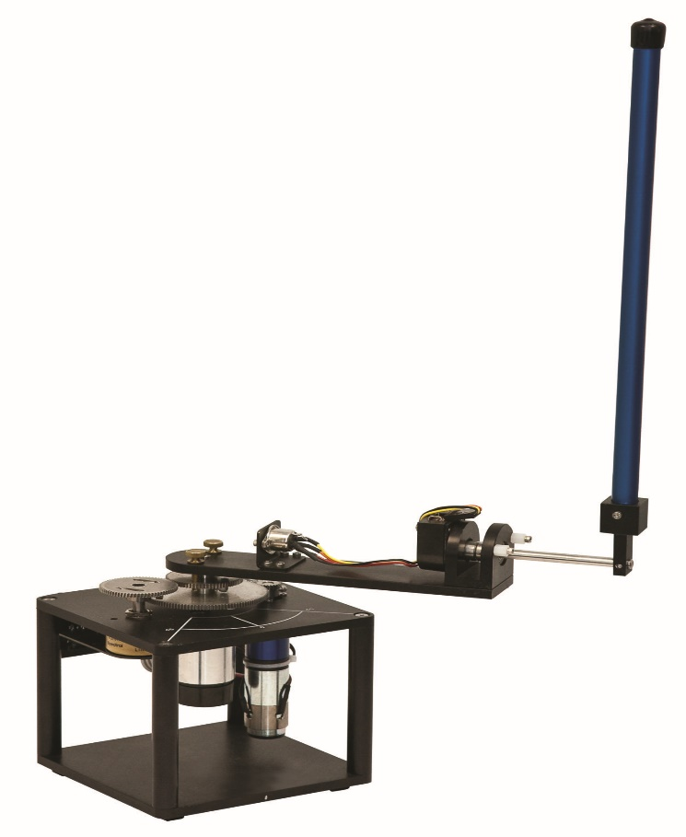
ROTARY INVERTED PENDULUM

Slide 3
CONTENTS
INTRODUCTION
COMPONENTS
WORKING PRINCIPLE
DYNAMICAL EQUATIONS
ASSUMPTIONS
APPLICATIONS
REFERENCES

Slide 4
INTRODUCTION
Inverted pendulum is a highly non-linear and open loop unstable system.
It has two equilibrium points :-
1. Normal downward position (180 degrees) which is a
stable equilibrium point
2. Vertically upward position (0 degrees) which is an
unstable equilibrium point

Slide 5
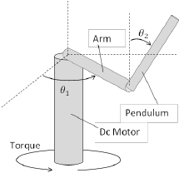
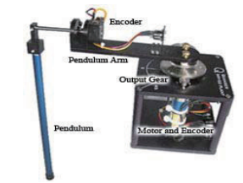
COMPONENTS
Rotary inverted pendulum consists of
following parts:-
DC Motor
Arm
Encoder
Pendulum

Slide 6
WORKING PRINCIPLE
The DC motor drives an independent output gear whose angular position is measured by an encoder.
The rotary pendulum arm is mounted on the output gear.
The pendulum is attached to a hinge instrumented with another encoder at the end of the pendulum arm. This second encoder measures the angular position of the pendulum.
The system is interfaced by means of a data acquisition card and driven by Matlab / Simulink based real time software.

Slide 7
APPLICATIONS
It is a good model for:-
Attitude control of a space booster rocket and a satellite
An automatic aircraft landing system
Aircraft stabilization in the turbulent air-flow
Stabilization of a cabin in a ship

Slide 8
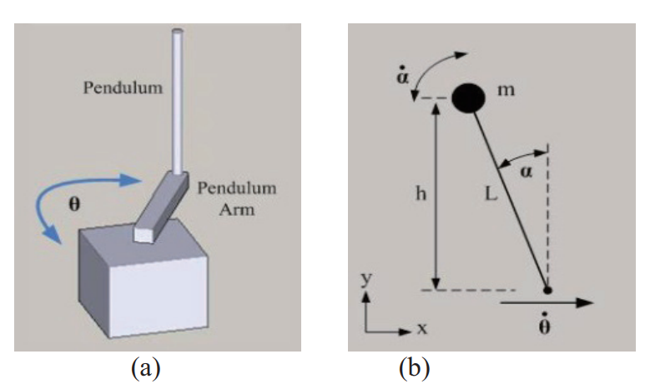









MATHEMATICAL MODELING OF ROTARY MOTION INVERTED PENDULUM
Figure (a) shows the rotational direction of rotary inverted pendulum arm. From[2]
Figure (b) depicts the pendulum as a lump mass at half of the pendulum length. The pendulum is displaced with an angle while the direction of is in the x-direction of this illustration.

Slide 9
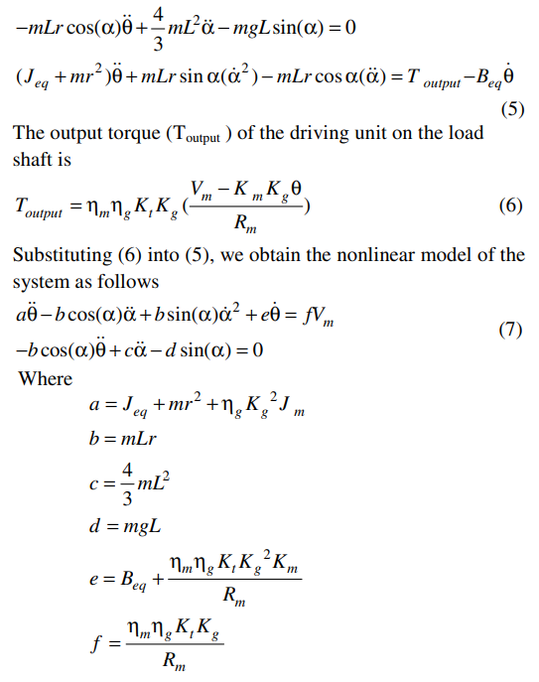
The output torque driving on the load shaft is
The final non linear equations are as follows…

Slide 10
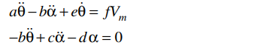
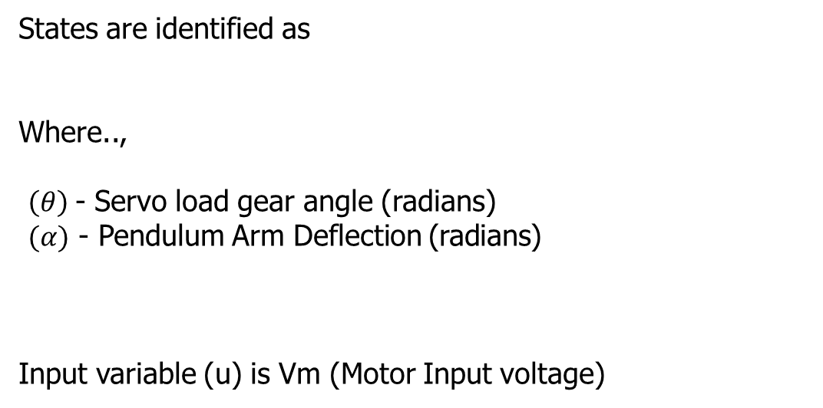

Linearizing under the assumption that alpha=0 ,we get the linearized model as follows:

Slide 11
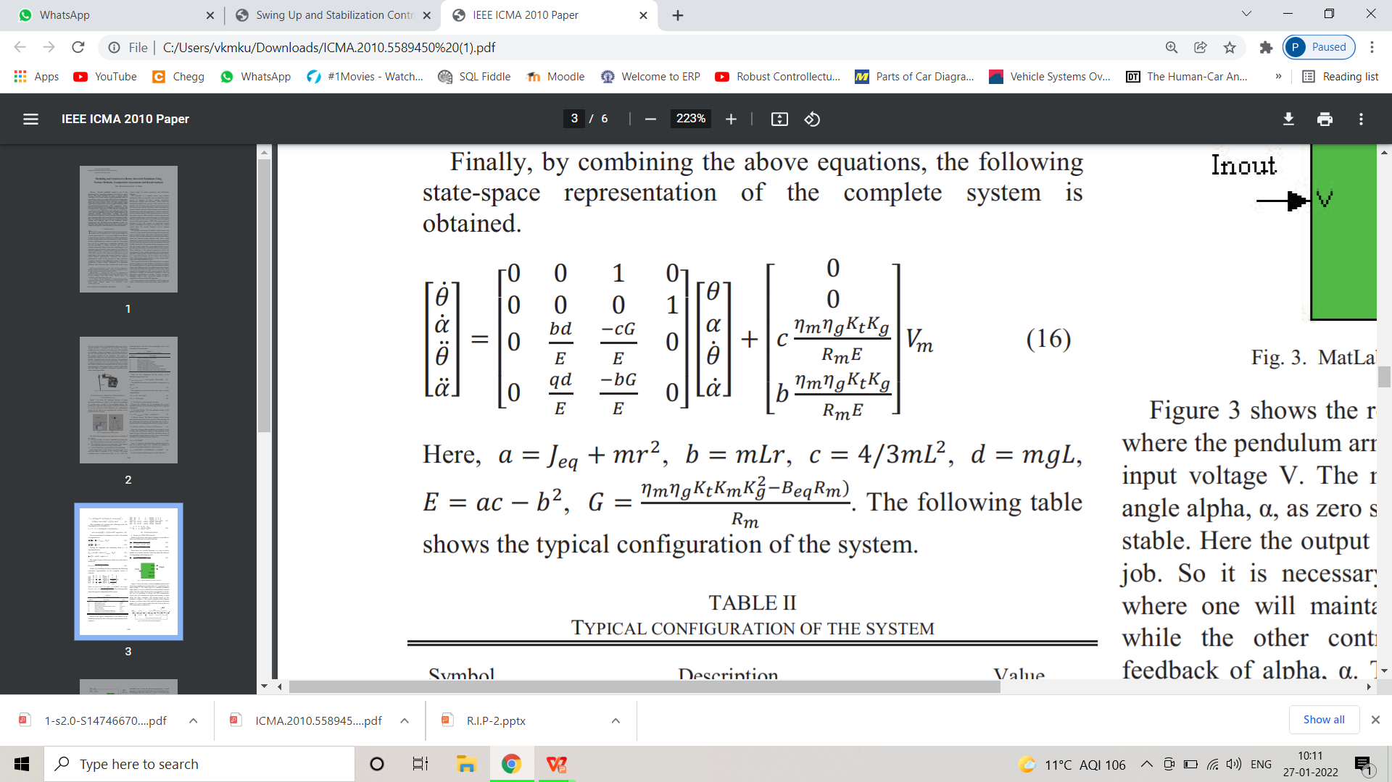
Finally the following state space representation of the complete system is obtained.

Slide 12
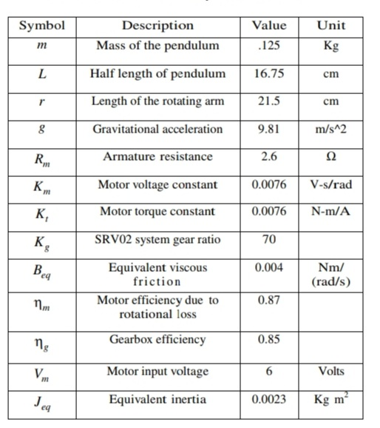
PARAMETERS
From [I]

Slide 13
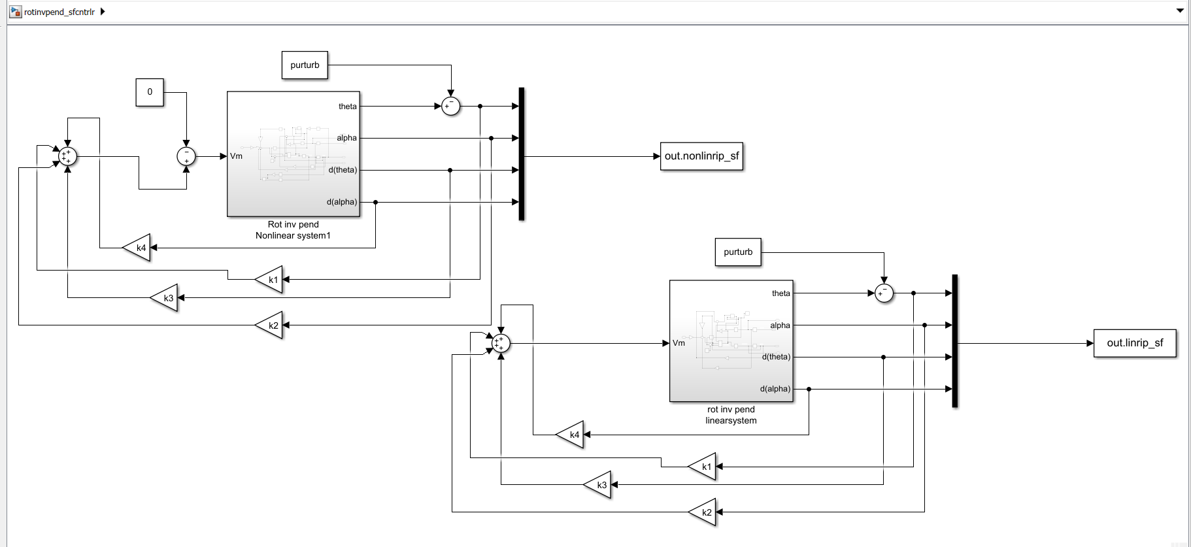
Simulink model of RIP with Full state feedback

Slide 14
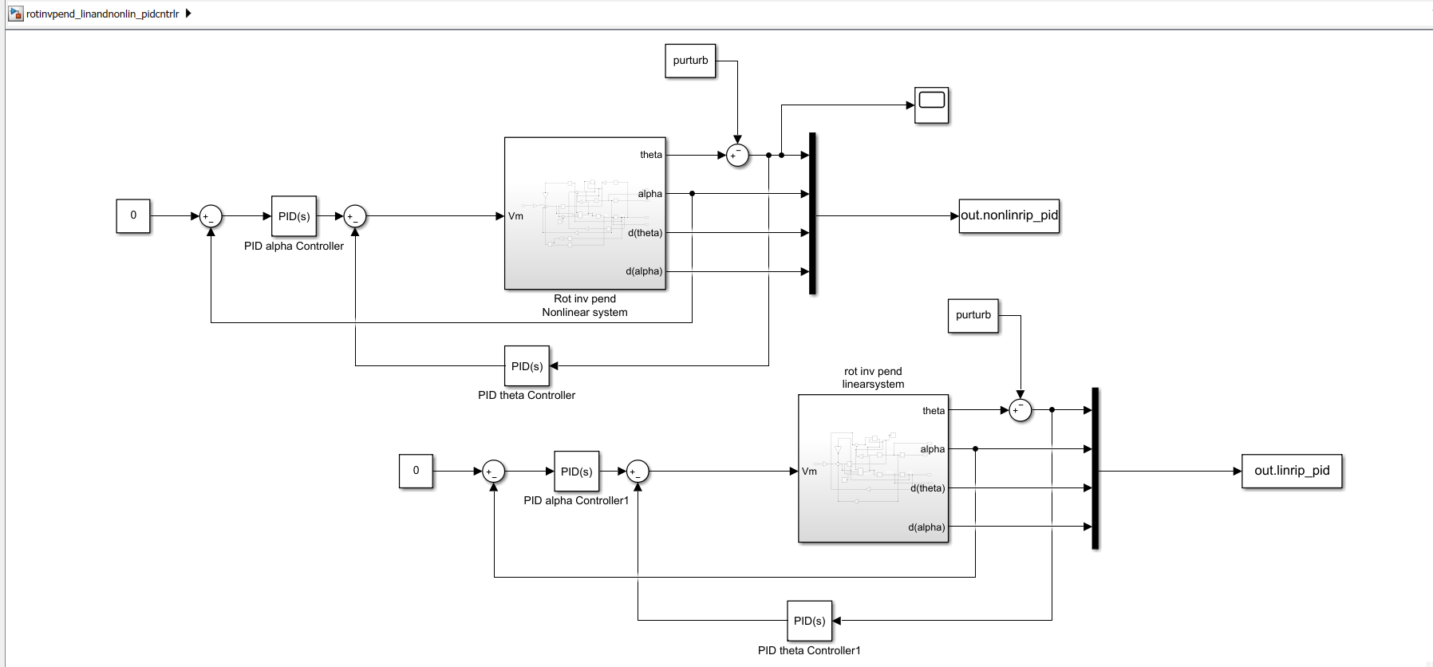
Simulink model of RIP with 2 DOF PID

Slide 15
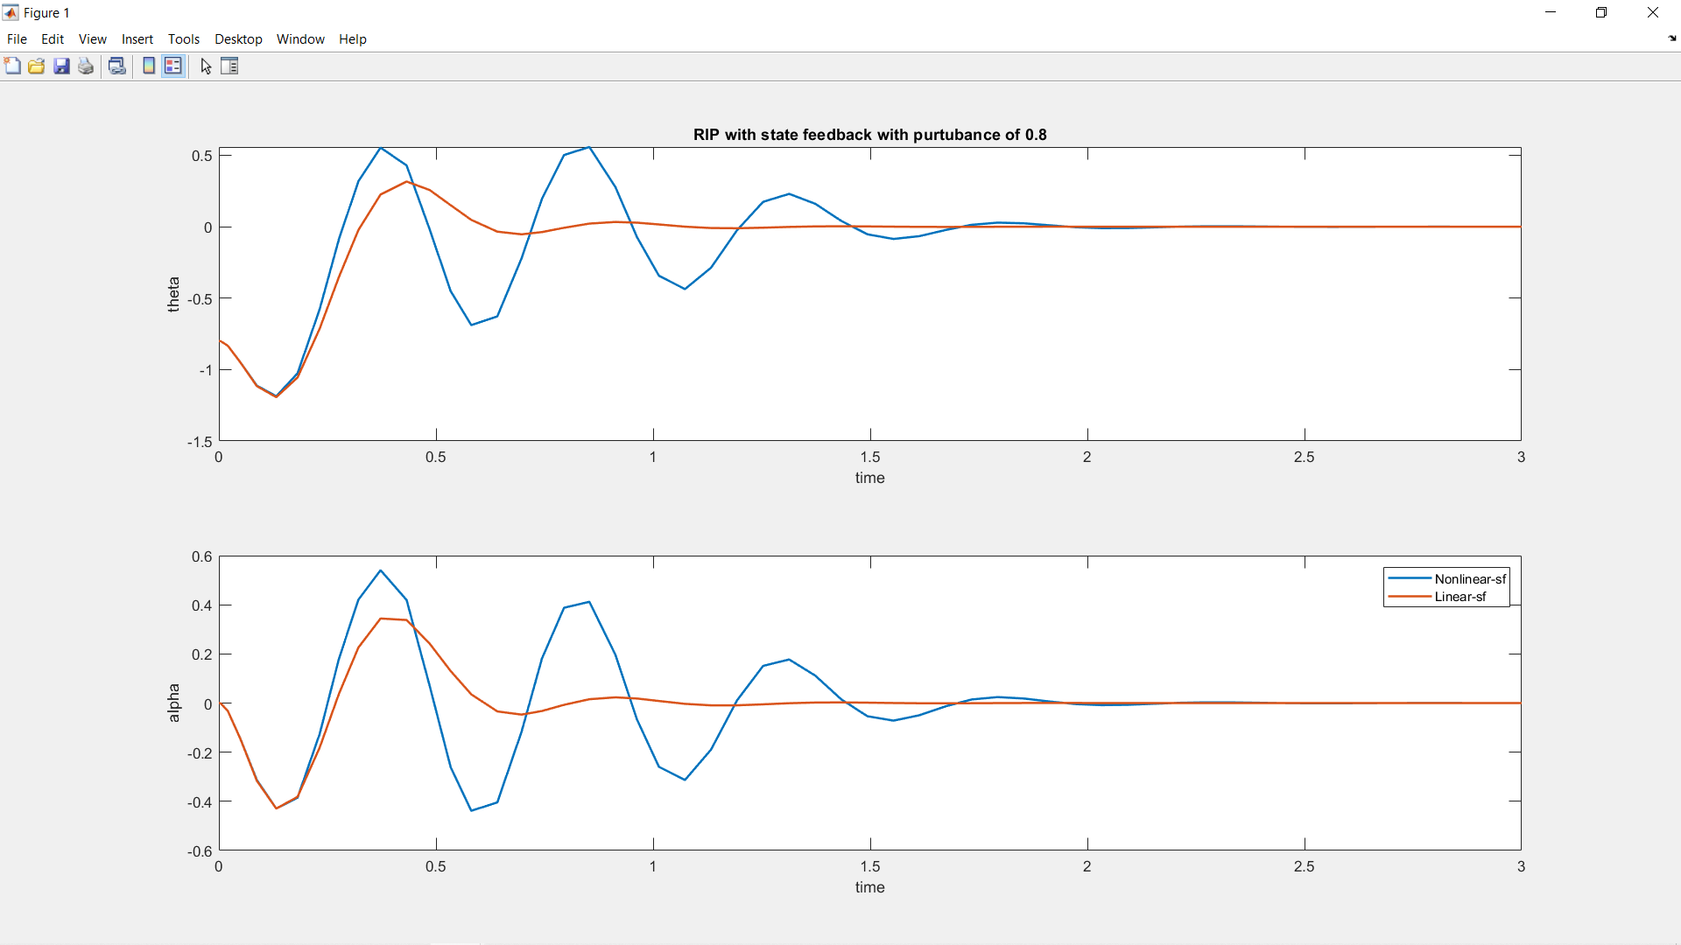
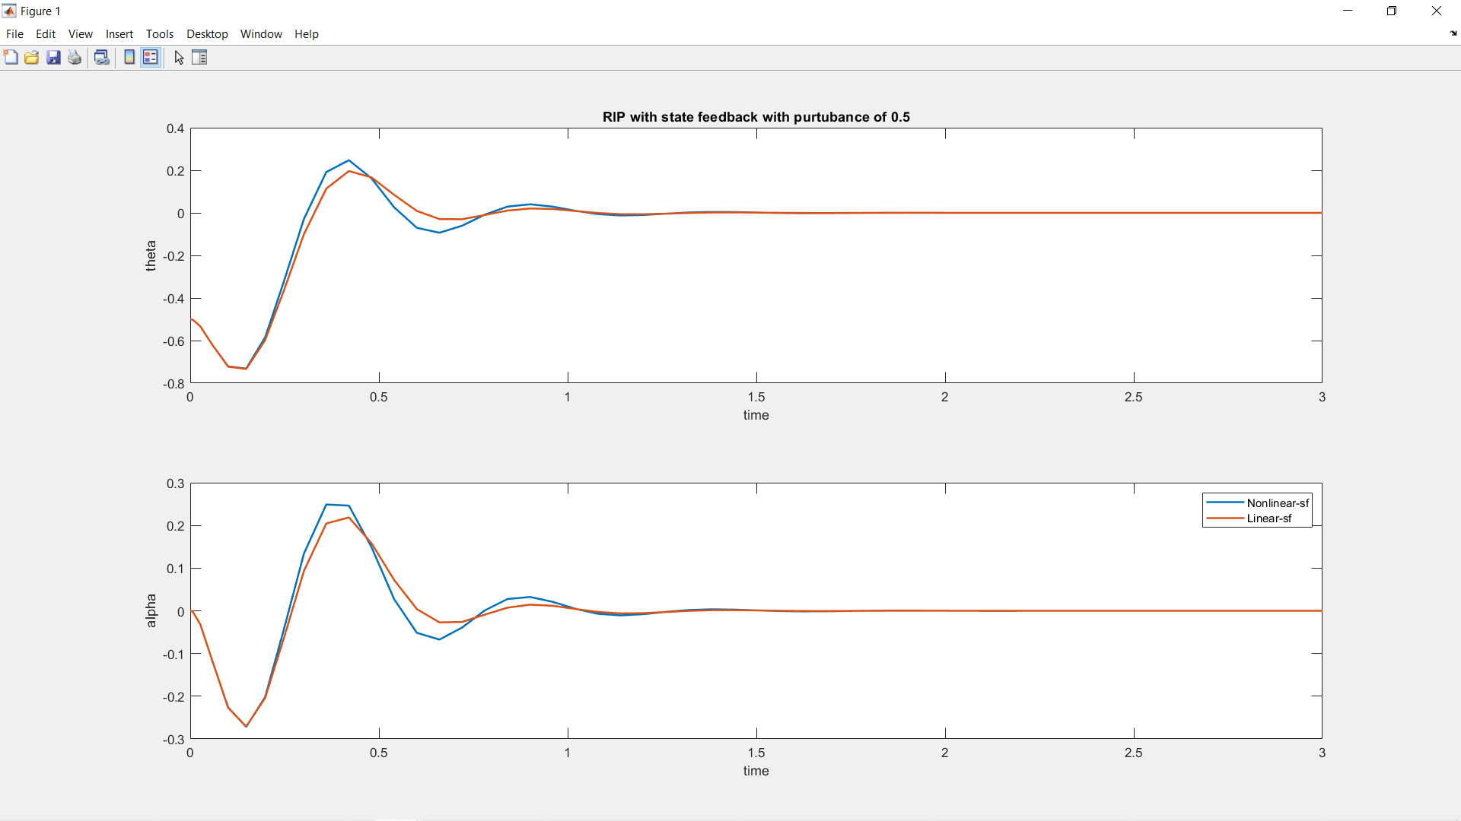
Closed loop RIP with full state feedback

Slide 16
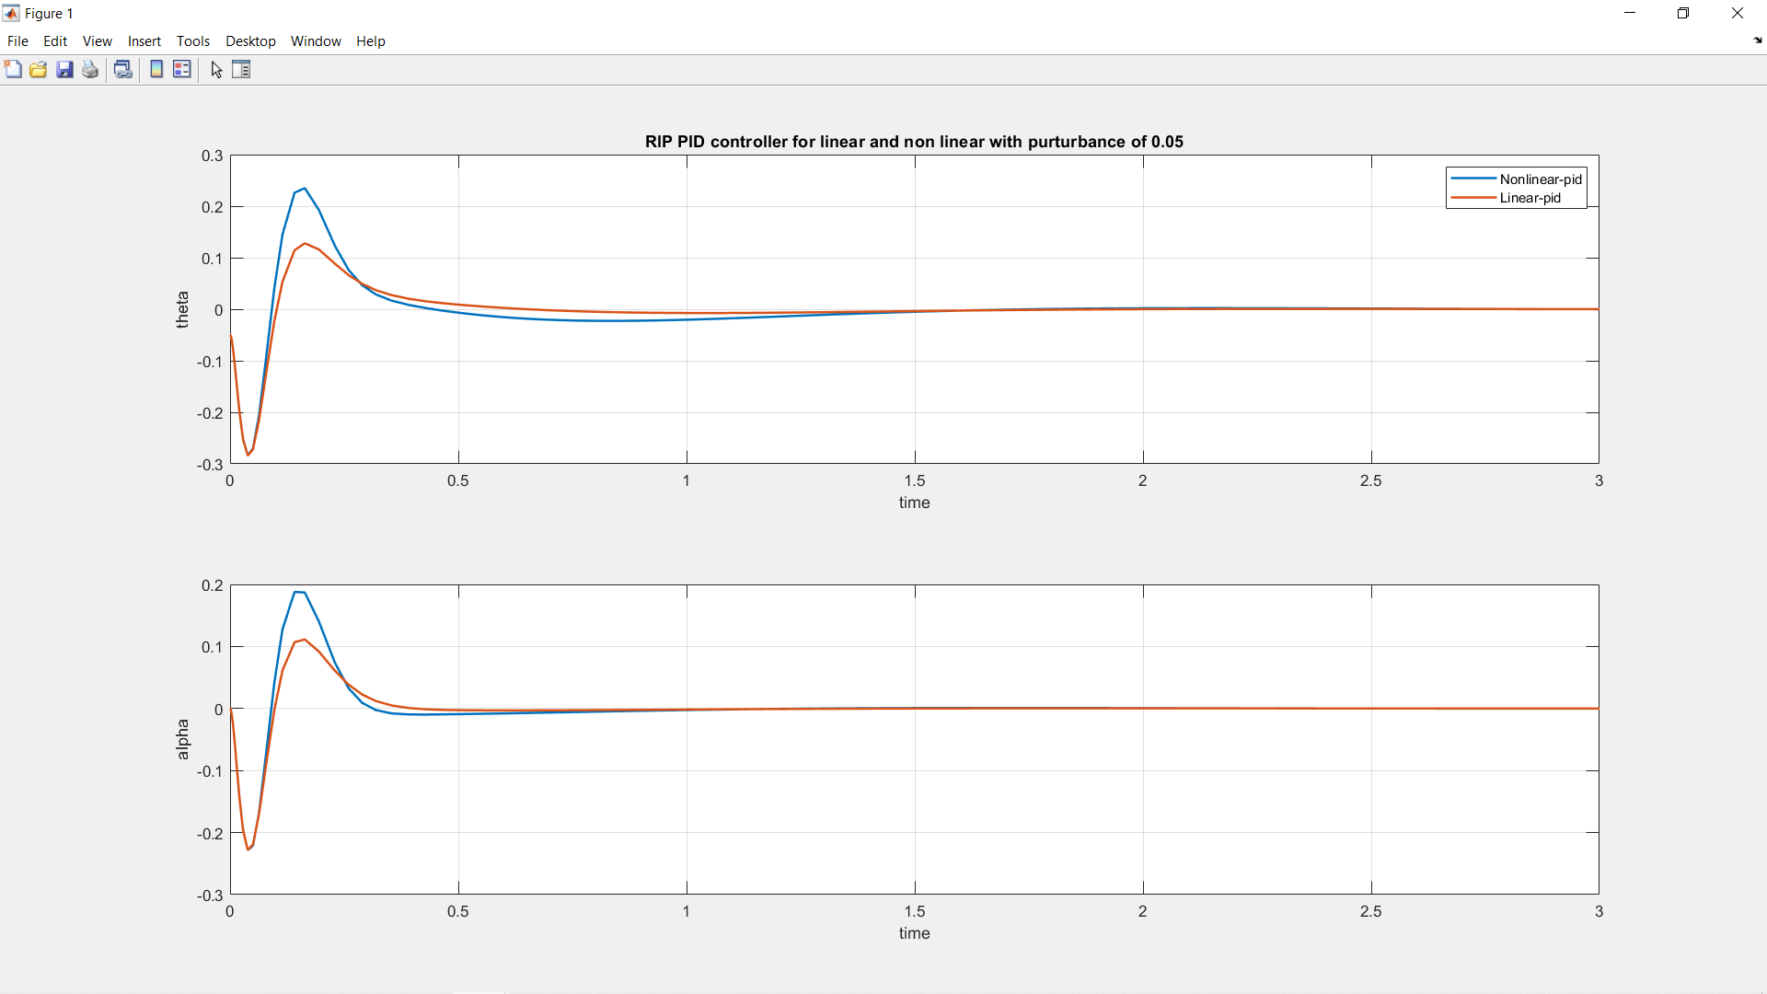
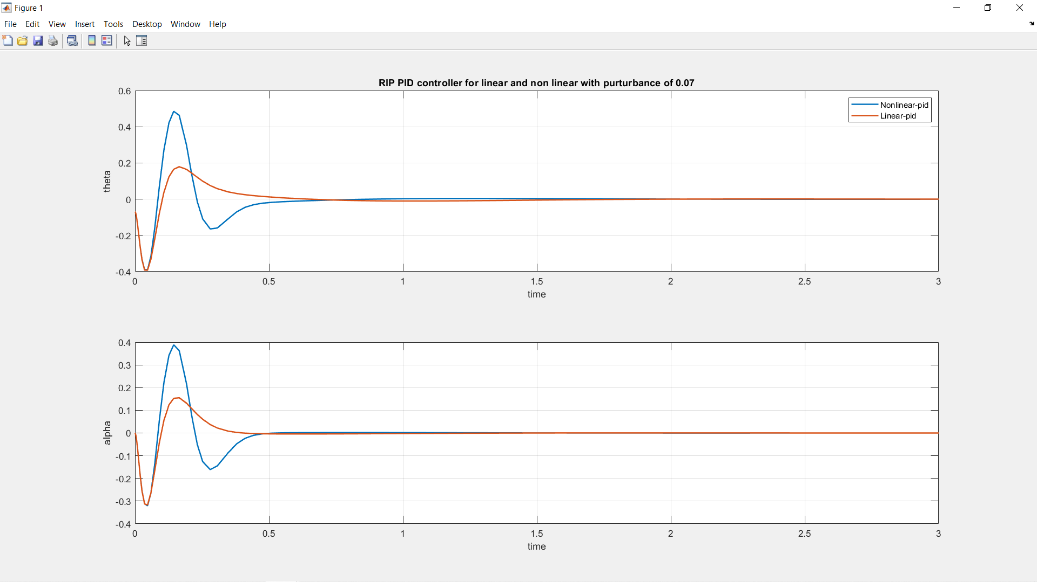
Closed loop RIP with 2DOF PID controller

Slide 17
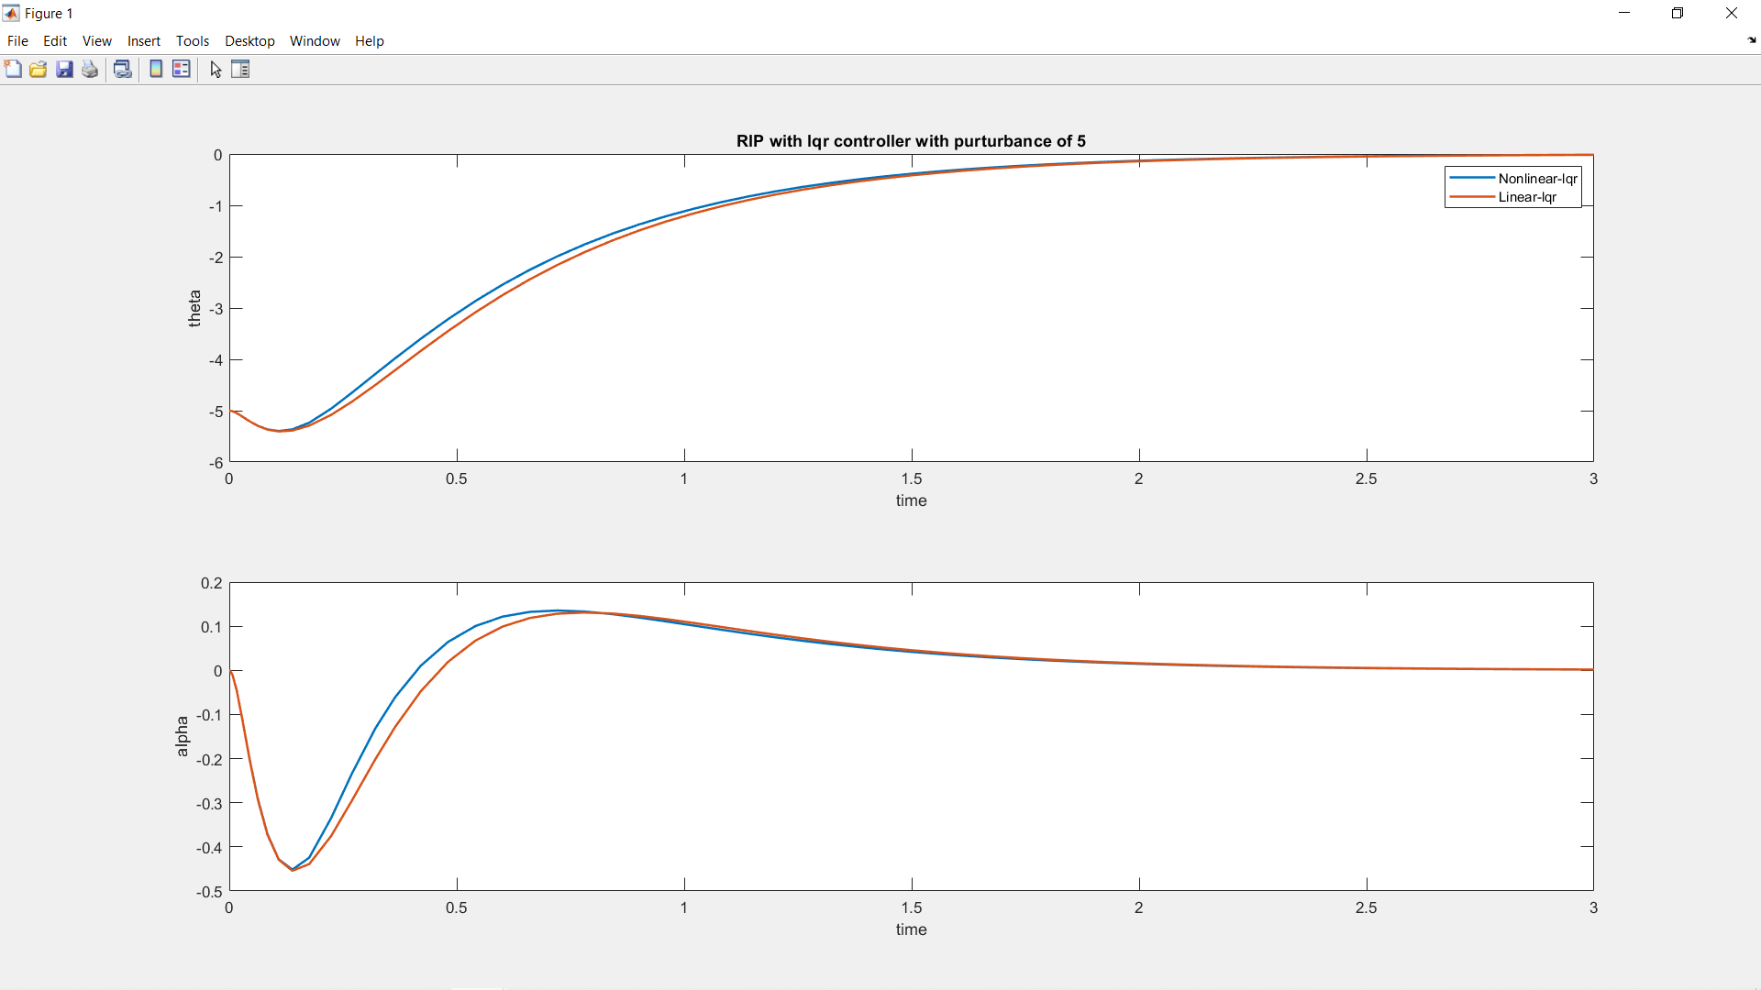
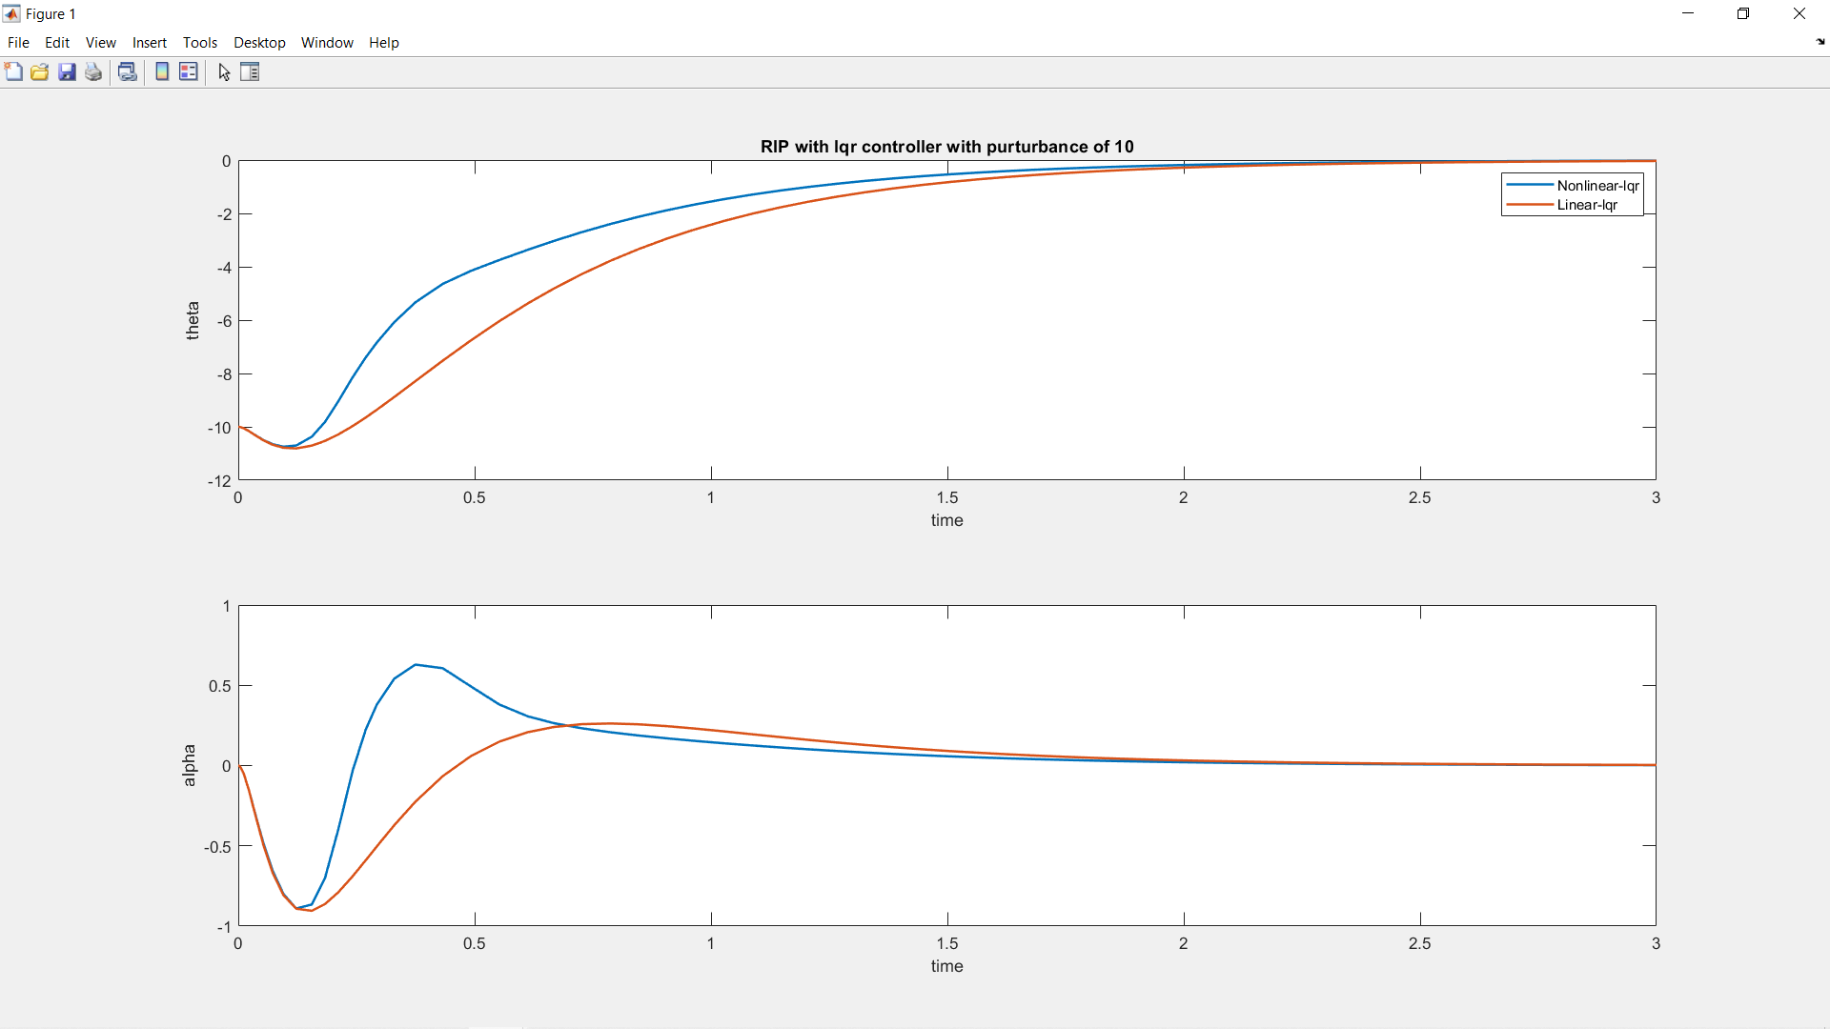
Closed loop RIP with LQR state feedback

Slide 18
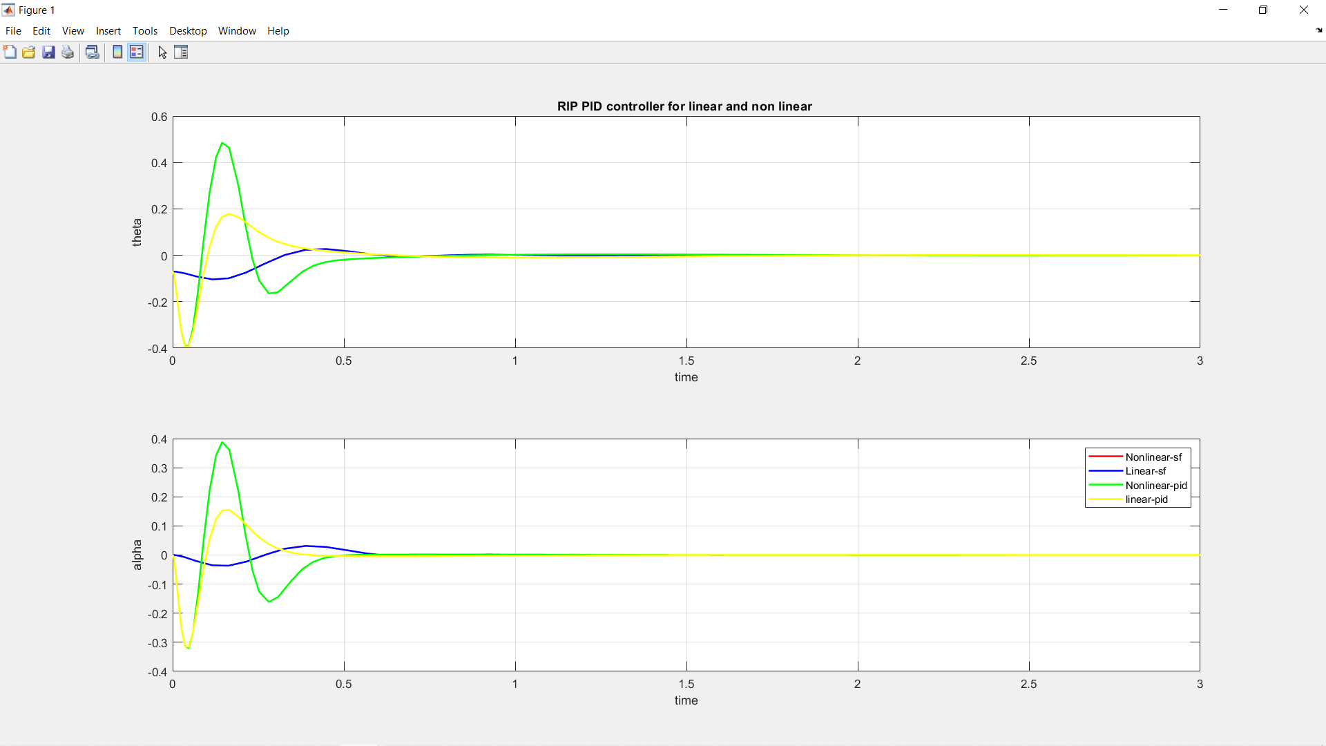
Comparison graph of RIP with FSF controller and 2DOF PID controller

Slide 19
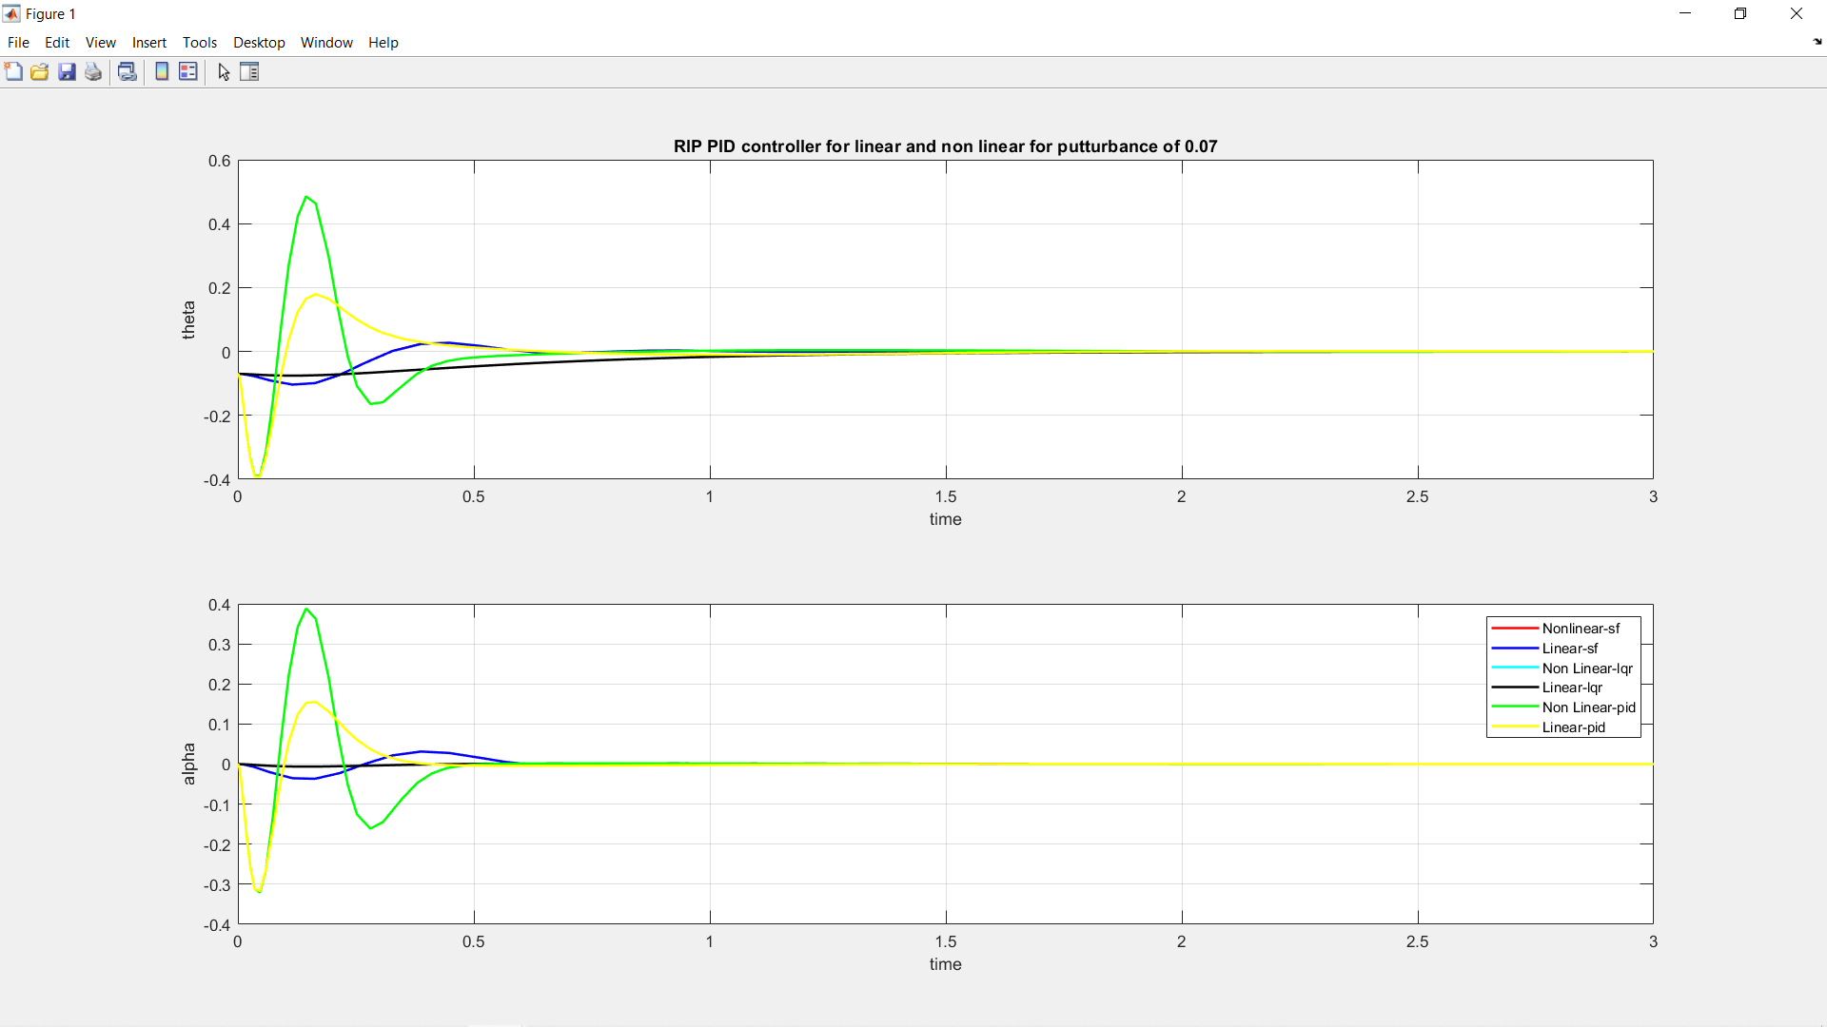
Comparison graph of RIP with FSF controller ,LQR feedback and 2DOF PID controller

Slide 20
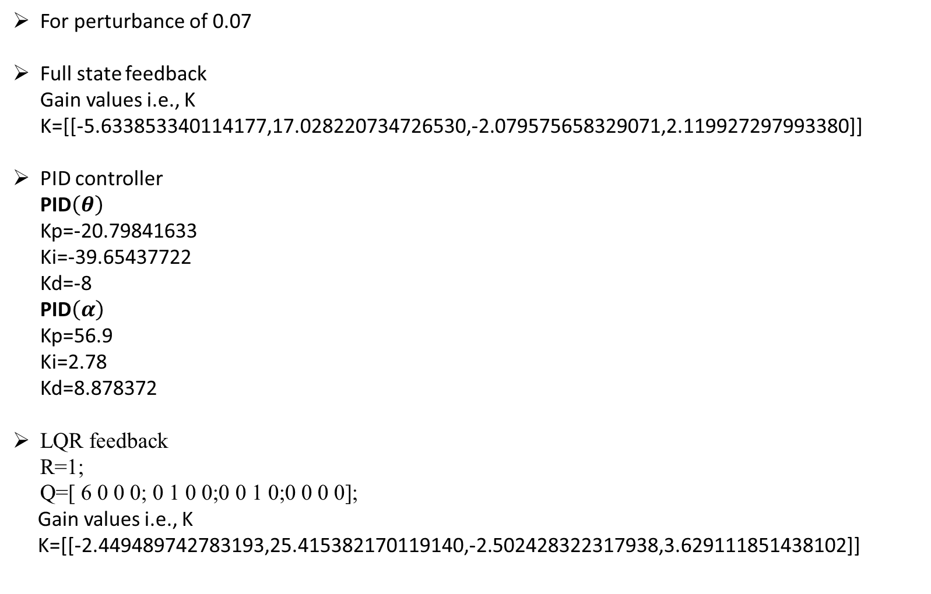
For perturbance of 0.07
Full state feedback Gain values i.e., K K=[[-5.633853340114177,17.028220734726530,-2.079575658329071,2.119927297993380]]
PID controller PID$\left(θ\right)$ Kp=-20.79841633 Ki=-39.65437722 Kd=-8 PID$\left(α\right)$ Kp=56.9 Ki=2.78 Kd=8.878372
LQR feedback R=1;
Q=[ 6 0 0 0; 0 1 0 0;0 0 1 0;0 0 0 0]; Gain values i.e., K K=[[-2.449489742783193,25.415382170119140,-2.502428322317938,3.629111851438102]]

Slide 21
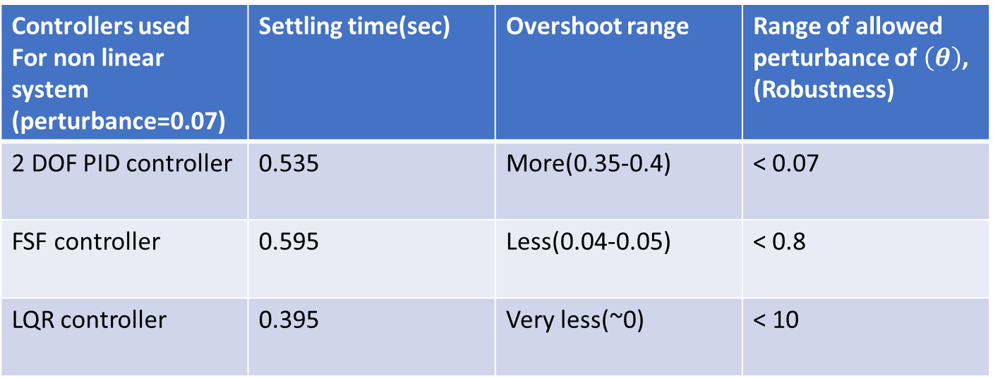
Comparison and Conclusion
Controllers used For non linear system (perturbance=0.07) | Settling time(sec) | Overshoot range | Range of allowed perturbance of $\left(θ\right)$, (Robustness)
2 DOF PID controller | 0.535 | More(0.35-0.4) | < 0.07
FSF controller | 0.595 | Less(0.04-0.05) | < 0.8
LQR controller | 0.395 | Very less(~0) | < 10
Thus, By above table we can observe that LQR controller performs better then followed by FSF controller and 2DOF PID controller

Slide 22
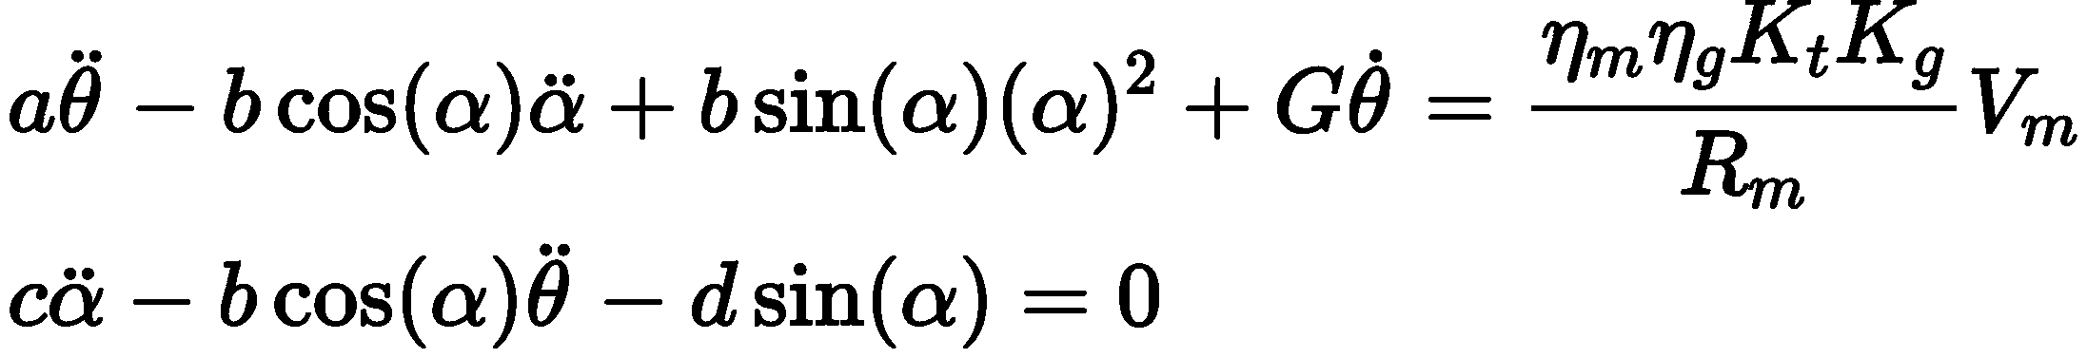
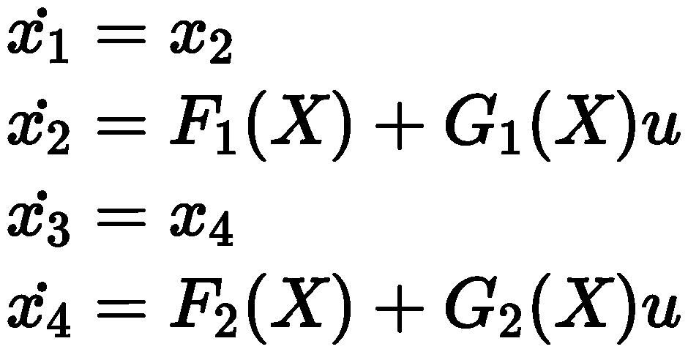
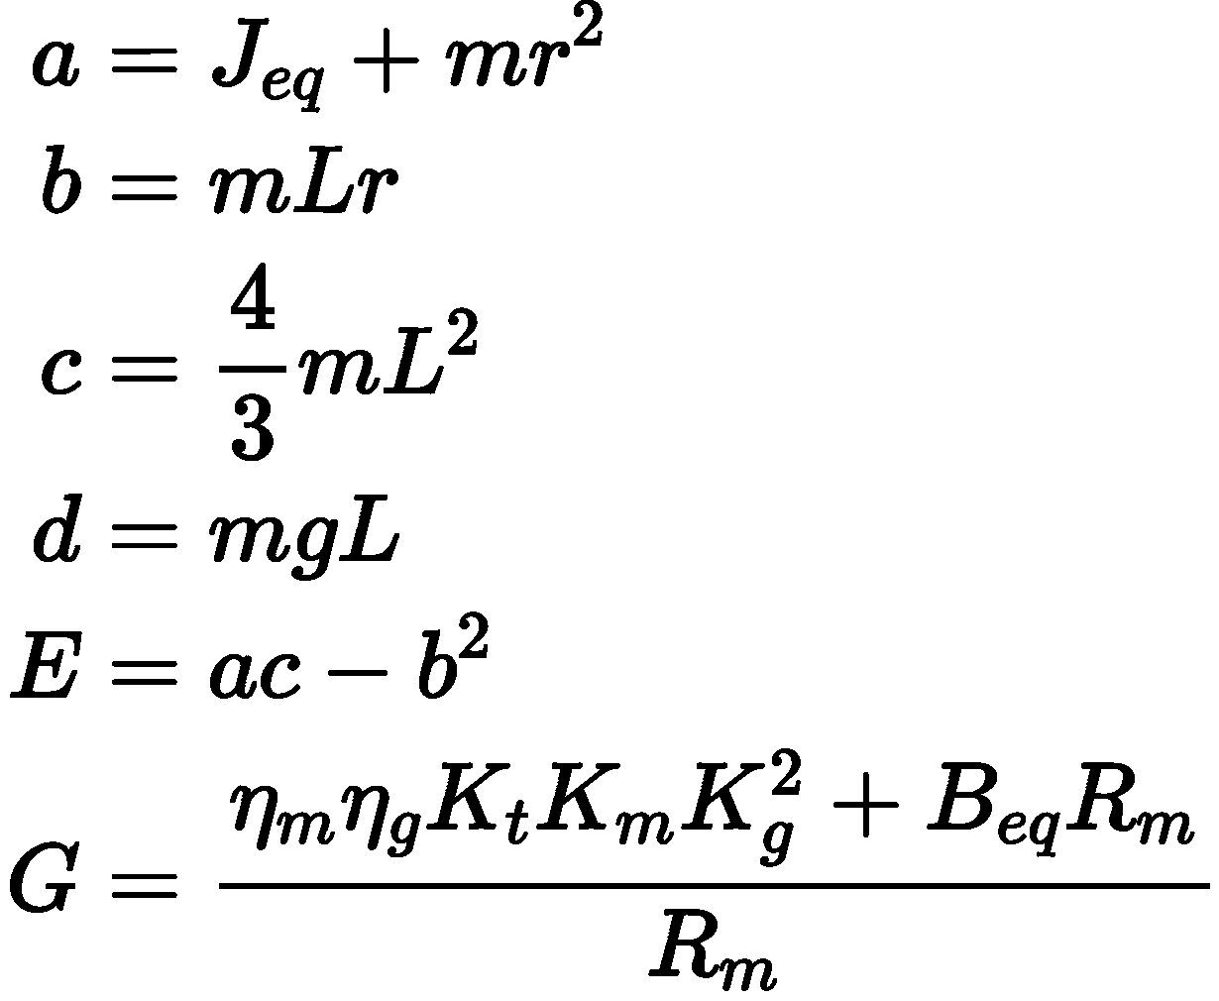
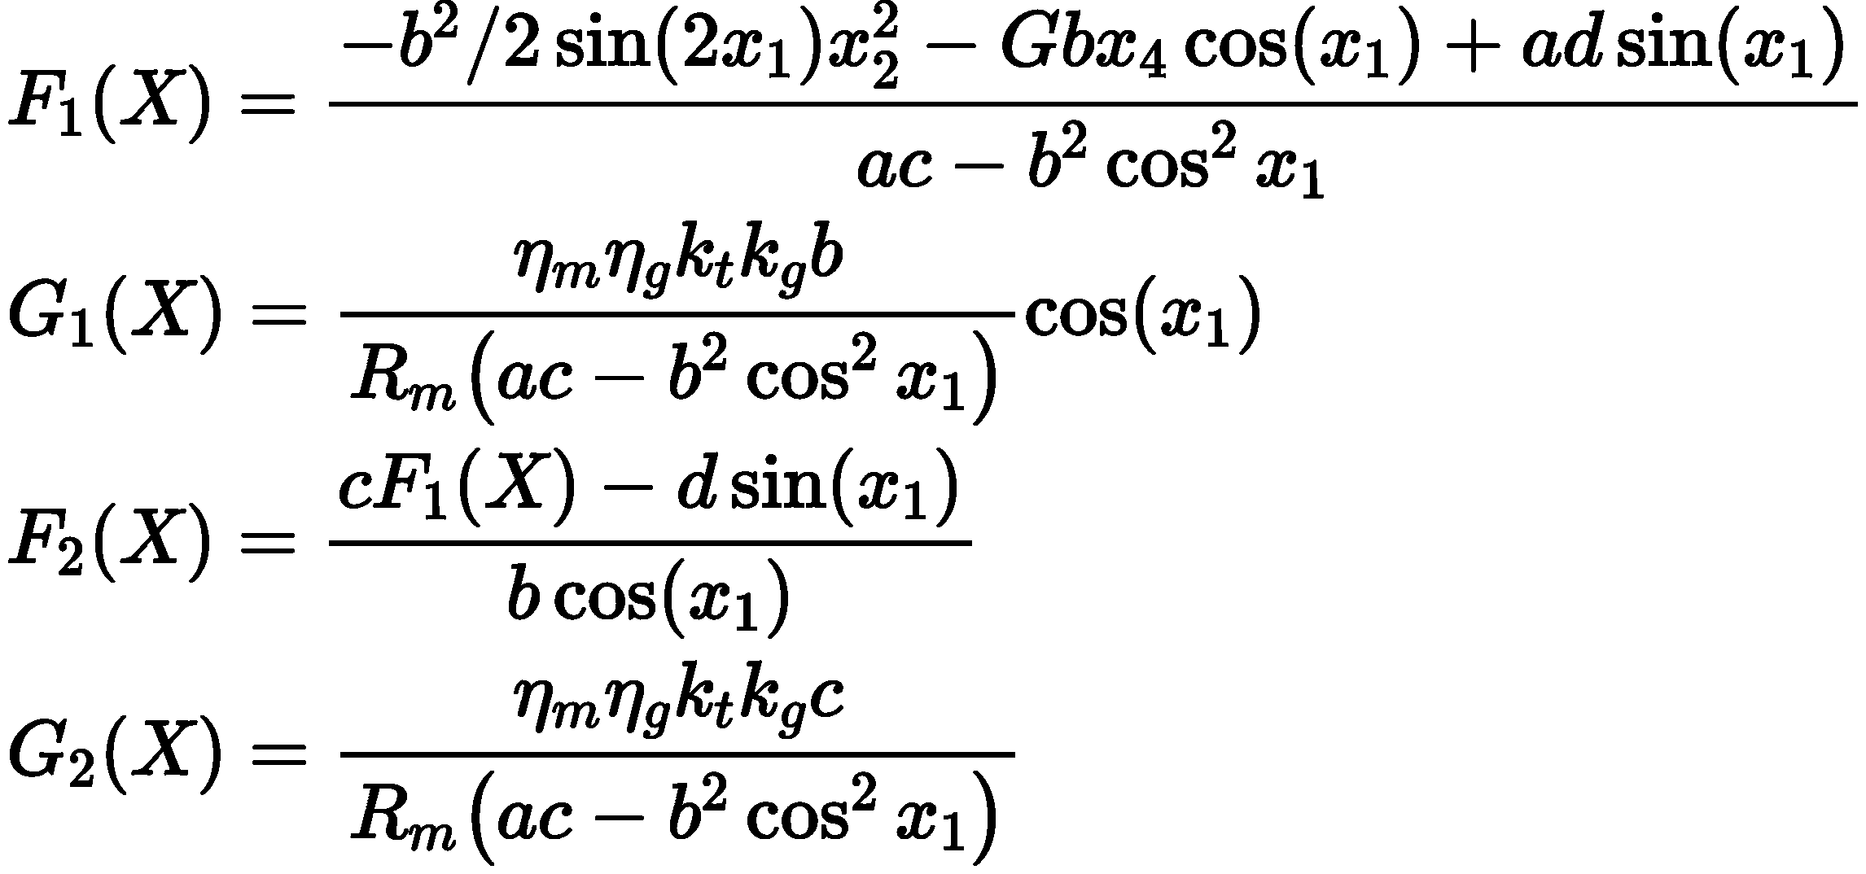

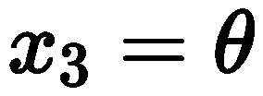
Feedback linearization
System equations

Slide 23
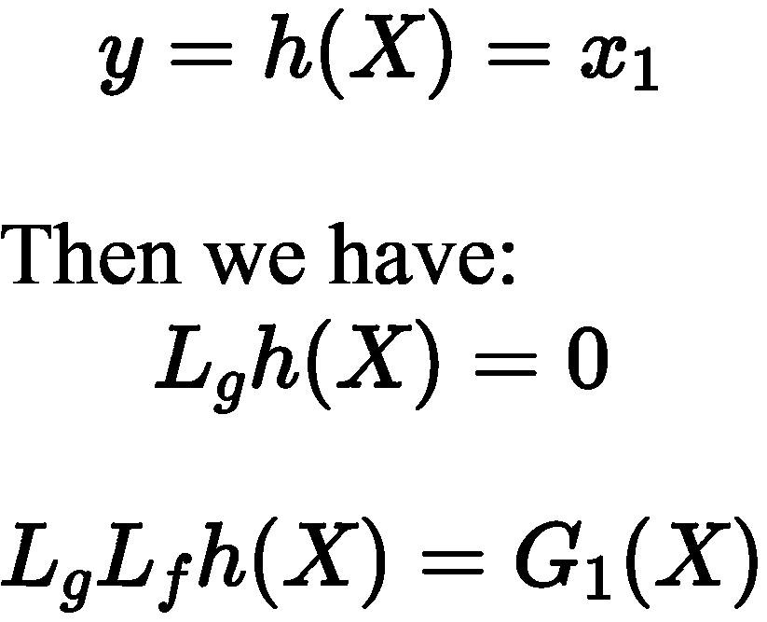
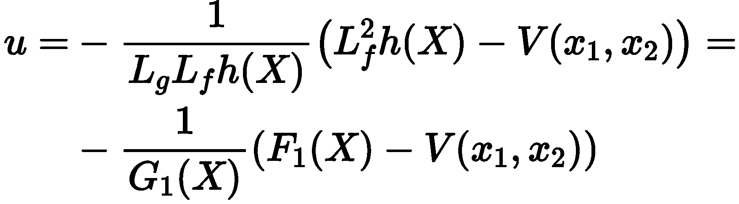
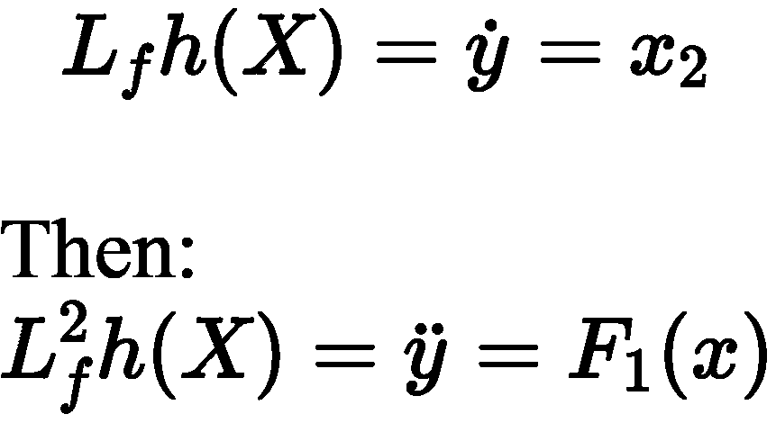
Finally we get u as…
where V(x1, x2) is the controller applied to the linearized system
And V(0,0)=0

Slide 24
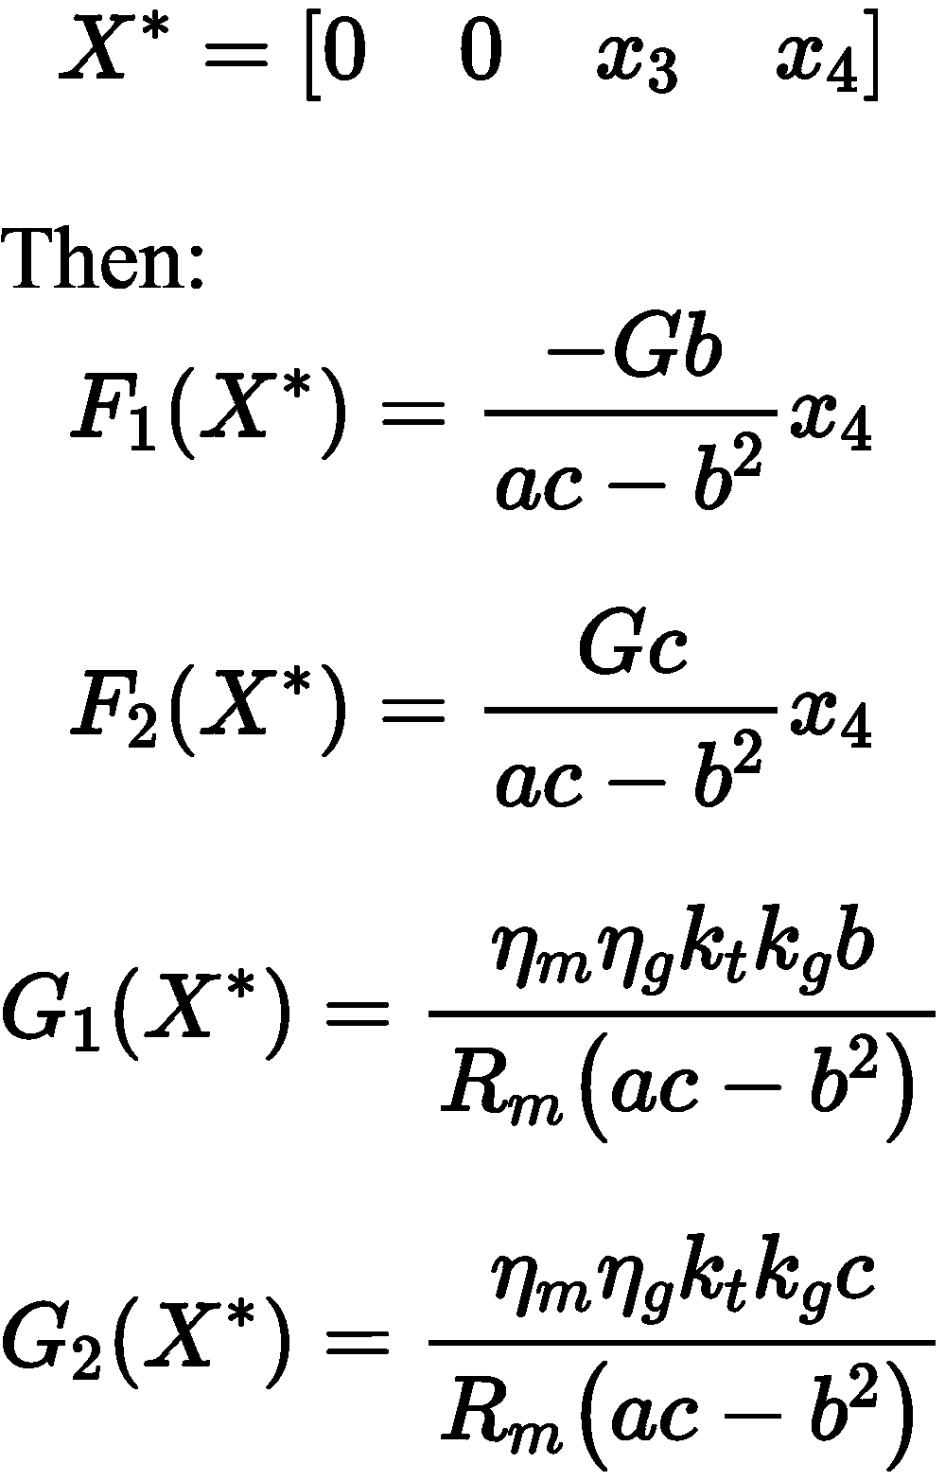
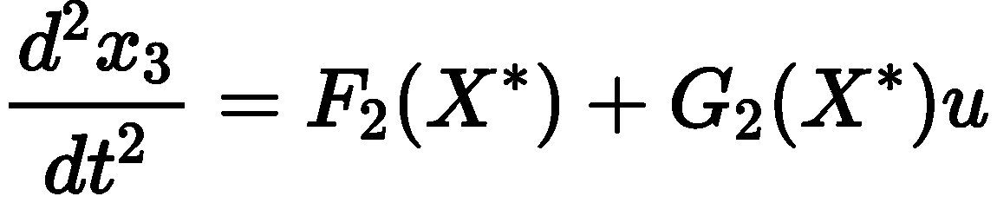
Analysis of zero dynamics of the system
The obtained zero dynamic of the system are unstable.
We can observe the non minimum phase so, we cant implement this feedback linearization and go for sliding mode control

Slide 25
REFERENCES
Navin John Mathew, K. Koteswara Rao, N. Sivakumaran,"Swing Up and Stabilization Control of a Rotary Inverted Pendulum,"IFAC Proceedings Volumes,Volume 46, Issue 32,2013
M. Akhtaruzzaman and A. A. Shafie, "Modeling and control of a rotary inverted pendulum using various methods, comparative assessment and result analysis," 2010 IEEE International Conference on Mechatronics and Automation, 2010.

Slide 26
Thank you

